Slide 1
Efficient Routing of Video requests using built-in content caching
PROJECT GUIDE
Ms.J.Sharon Ranjitha Esther
AP/IT
TEAM
Surekha Sreethar
(212713205096)
Nikhil Bharath.R
(212713205059)

Slide 2
Basic concepts
A content delivery network or content distribution network (CDN) is a globally distributed network of proxy servers deployed in multiple data centres.
PDN is a packet switched network which routes small units of data called packets based on destination address.
Local gateways forwards the data from the user to the PDN.It is distinguished based on the location
Super source entry contains information about traffic intensity and availability of videos at the local cache and redirects the video requests.

Slide 3
Basic concepts
Built-in cache is maintained in the local gateways.
In graph theory, the shortest path problem is the problem of finding a path between two vertices (or nodes) in a graph such that the sum of the weights of its constituent edges is minimized.
In computer science, binary search also known as half-interval search or logarithmic search, is a search algorithm that finds the position of a target value within a sorted array
Binary search compares the target value to the middle element of the array; if they are unequal, the half in which the target cannot lie is eliminated and the search continues on the remaining half until it is successful or the remaining half is empty.

Slide 4
Abstract
Built-in content caching in mobile core networks can help improve quality of service, reduce operation expenses, simplify inter-network cooperation, and thus is a promising approach for more efficient networking architectures.
Two problems must be addressed: (i) how to distribute video requests among multiple internal servers (i.e., server selection); and (ii) how to route so-generated video flows (i.e., flow routing).
Proposed work considers two problems with two traffic-engineering objectives considered, namely, minimizing maximum link utilization and minimizing total link cost. Fast algorithm is developed to solve the problems with provable approximation guarantees.
A hop-by-hop routing protocol is proposed, which implements the optimization solutions by generating a set of flow-splitting and routing decisions for each router/caching node.

Slide 5
LITERATURE SURVEY

Slide 6
TITLE: Netflix: Understanding and Improving Multi-CDN Movie Delivery
AUTHOR: Vijay Kumar Adhikari
PUBLISHED IN: 2012
DESCRIPTION:
Netflix is one of the leading internet subscription service companies.
Hence understanding the architecture and performance of Netflix can shed light on how to optimize its design as well as optimize the design of similar on-demand streaming services.
A periodic computation of the three CDN’s employed by Netflix is done, in order to measure the delivery bandwidth.
Hence , a multiple CDN based selection and delivery strategy is being proposed.
DISADVANTAGE: High latency and overhead.

Slide 7
TITLE: Optimal Content Placement for a Large-Scale VoD System
AUTHOR: David Applegate, Aaron Archer, AT&T labs
DESCRIPTION:
PTV service providers offering Video-on-Demand typically provide many servers at each metropolitan office to store all the videos in the library.
It will soon become infeasible to replicate the entire library at each office, as the Video On Demand library size is increasing.
They have also adopted simple strategies to optimize the quality of experience of the user and the network load.
The mixed integer programming is going to deal with the key constraints like disk space and link bandwidth.
DISADVANTAGE : Maximum link cost

Slide 8
TITLE: A Collaborative Framework for In-network Video Caching in Mobile Networks
AUTHOR: Jun He, Honghai Zhang, University of Science and Technology of China.
PUBLISHED IN: 2014
DESCRIPTION :
The need to place frequently accessed information close to the requestor is becoming progressively important.
However, this is a difficult problem due to the large number of online videos and video requests, limited capacity of caching nodes, and limited bandwidth of in-network links .
The existing solutions which rely on static configurations and average request arrival rates are insufficient to handle dynamic request patterns effectively.
Hence this caching problem is divided into two sub problems:
Content placement
Source selection
DISADVANTAGE : Not very effective in storing online videos.

Slide 9
TITLE: Coordinating In-Network Caching in Content-Centric Networks: Model and Analysis
AUTHOR : Yanhua Li, Haiyong Xie, University of Minnesota
PUBLISHED IN : 2015
DESCRIPTION :
In-network content storage has become an inborn capability of routers in the content-centric networking architecture.
In order to stabilize the trade-off between the cost and the network performance, it becomes important to provision each router with a cache.
Hence, they proposed a holistic model to characterize the network performance of routing contents to clients and the network cost incurred by globally coordinating the in-network storage capability
DISADVANTAGE: Storage cost

Slide 10
Issues and Challenges
Data traffic occurs when multiple users request the same video.
When traffic is high, routing of video requests becomes difficult.
Selecting a local gateway where traffic is low is a major challenge
Hence the server selection is done by the super source node.

Slide 11
Existing System
The core network system namely Evolved Packet Core is an all IP core network, consisting of packet data network (PDN) gateways(P-GWs) and local gateways.
CDN is responsible for providing the response to the request initiated by the user.
Local gateways are now with Build-in cache for easy access of data for the customers.

Slide 12
Problem Definition
Data delivery is inefficient.
Requires extremely high data rate and stable connection.
Long Distance network also increases the complexity.
High data traffic due to inefficient load balancing technique.

Slide 13
Proposed System
Problem occurs when multiple users request for the same video.
Hence the proposed system will consists of the super source node which deals two major problems:
Server selection problem
The flow routing problem.
Thus, multiple sources and multiple paths for each request is being considered
One such proposed solution is hop-by-hop forwarding routing decisions, which lead to a complete request routing protocol.

Slide 14


Architecture diagram
Content delivery network
(CDN)
ADMIN
INTERNET
Packet data
network(PDN)
Local Gateway
(L-GW)CHENNAI
Local Gateway
(L-GW)HYD
SUPER SOURCE POINT
Local Gateway
(L-GW)MUMBAI
USER 2
USER 1

Slide 15
Modules
Upload video contents
Network Formation and Build Content Caching
Gateway Selection
Traffic engineering

Slide 16
Upload video contents
Videos are uploaded by the administrator.
The list of available videos can be viewed at the user end.
Maintainability of video contents are done by the administrator.

Slide 17
Network Formation and Build Content Caching
Local gateways are created, are differentiated based on their location.
L-GW forwards the video request to the CDN.
After sending the response to the user, L-GW stores the video in its cache.
The local gateway serves the video that are frequently requested by the users.

Slide 18
Gateway Selection
Super source entry is created for each request.
Handles multiple requests and selects a gateway.
The gateway selection based on two algorithms.
Shortest path Algorithm
Binary Search Algorithm
The shortest path algorithm reduces the maximum link utilization.

Slide 19
Traffic Engineering
The binary search algorithm minimizes the cost.
The traffic intensities are varied at the local gateways.
The videos are retrieved from the local gateway that has the least traffic value.

Slide 20
Flow chart
Start
User
request
Local gateway
Traffic?
No
Yes

Slide 21
Super source point
Available local gateway
User end
Stop

Slide 22
Algorithm
Shortest Path Algorithm
Binary Search Algorithm
Software Requirements
Windows 7 and above
JDK 1.8
Tomcat 6.0
Net beans

Slide 23
Hardware Requirements
Hard Disk : 250GB and Above
RAM : 4GB and Above
Processor : Intel i3 and Above
Technology Used
Java
J2EE (Jsp , Servlets)
Html

Slide 24
Gantt chart

Slide 25
Conclusion:
The main objective is to efficiently route the video request by considering traffic and link utilization
This is done with the help of super source point.

Slide 26
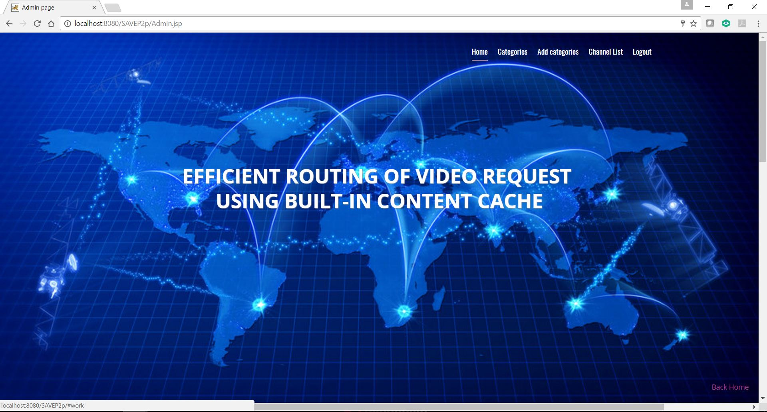

Slide 27
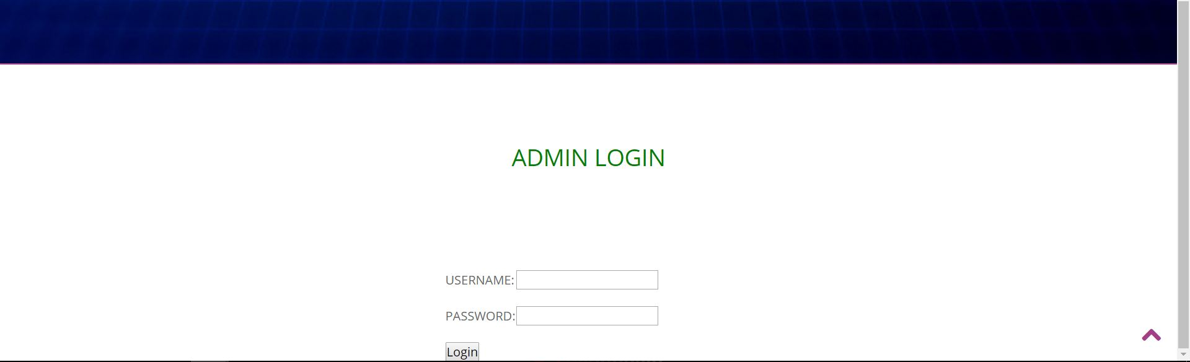

Slide 28
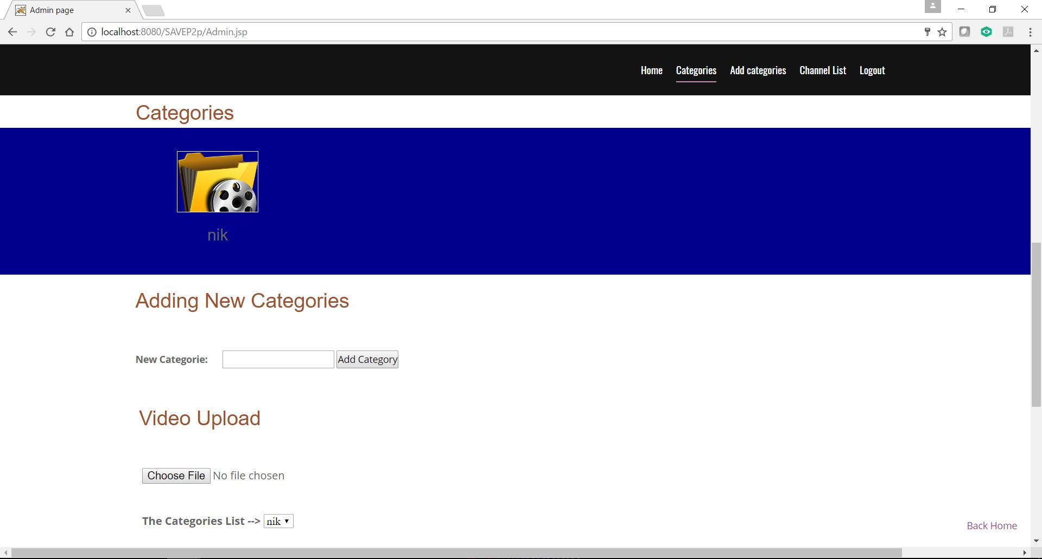

Slide 29
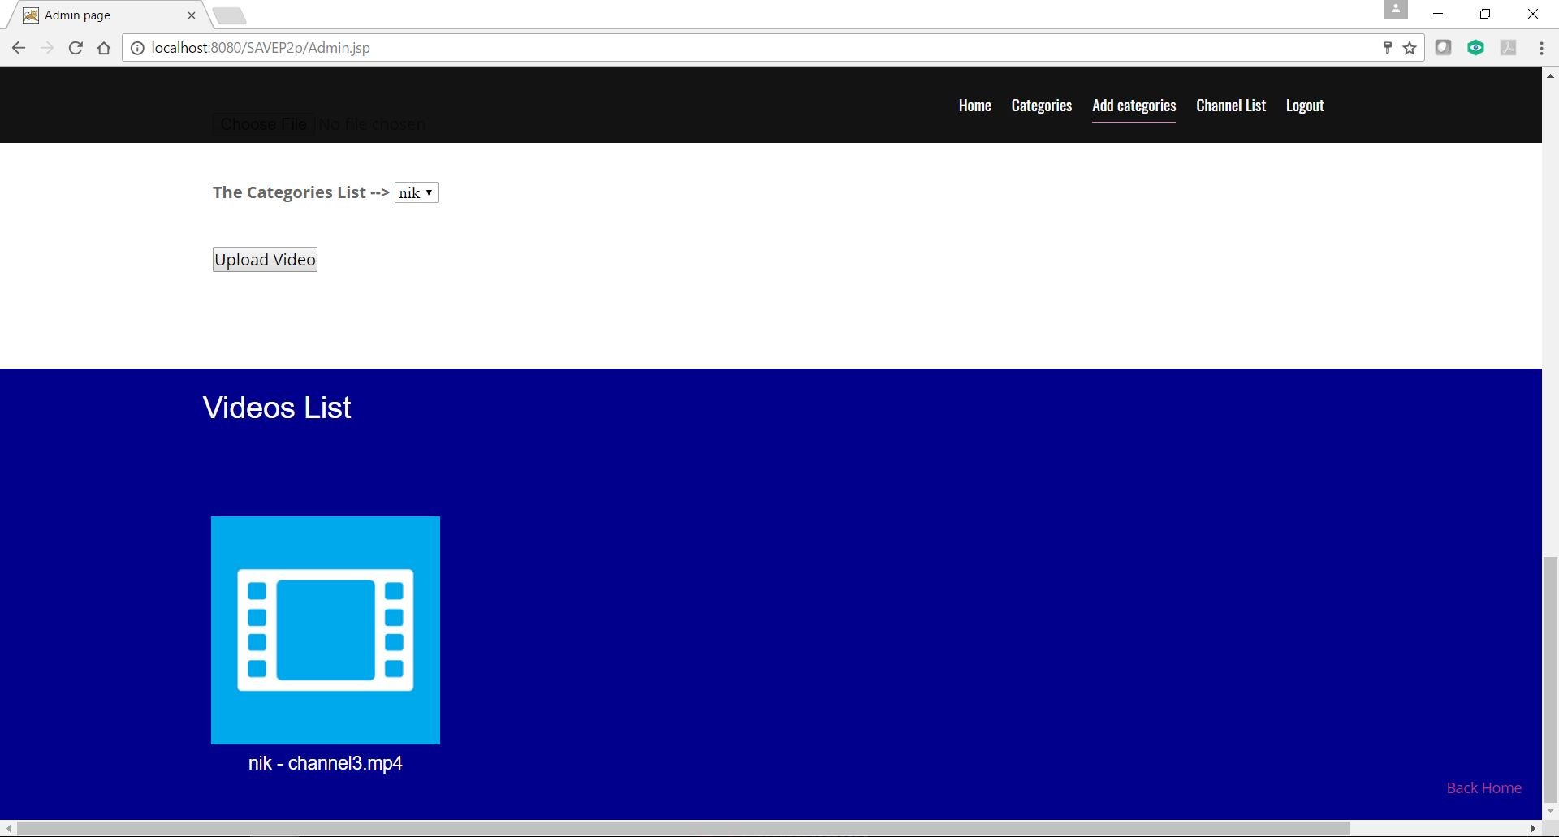

Slide 30
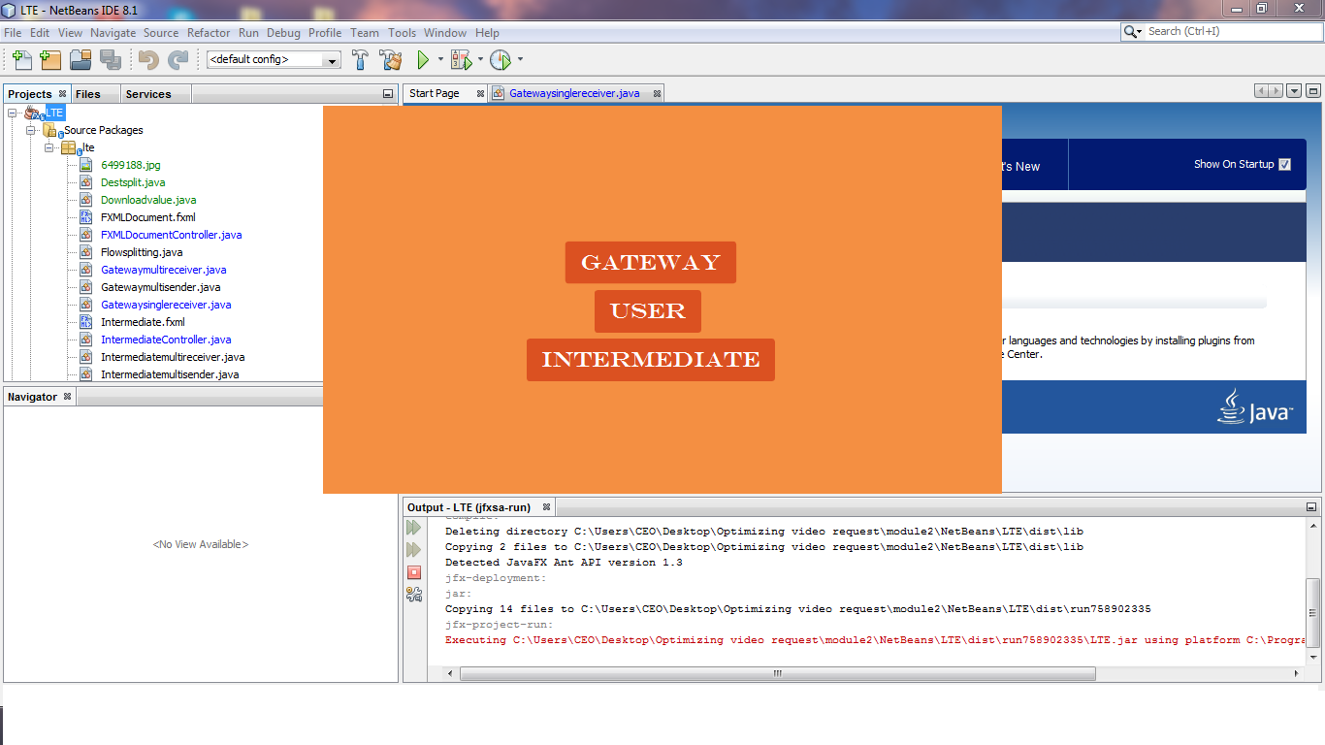

Slide 31
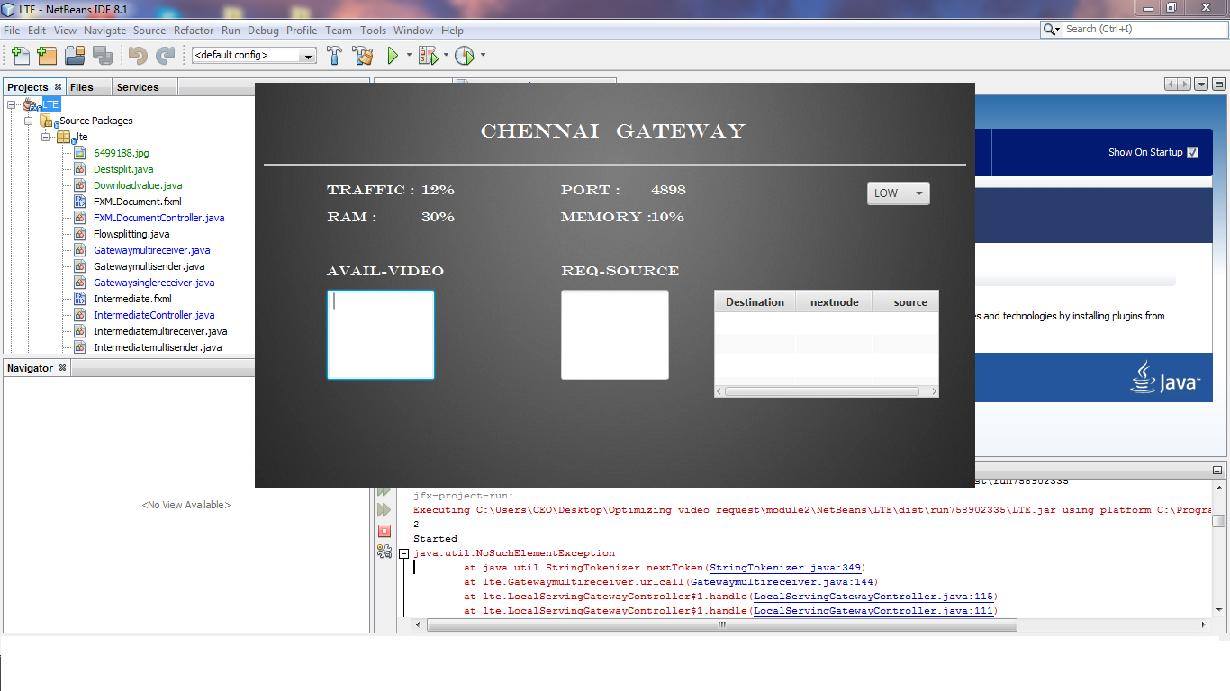

Slide 32
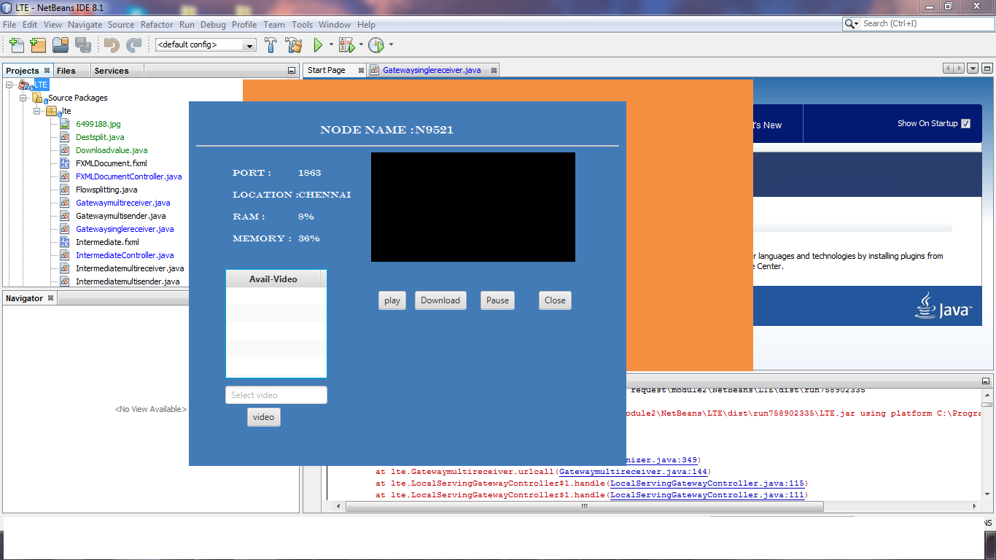

Slide 33
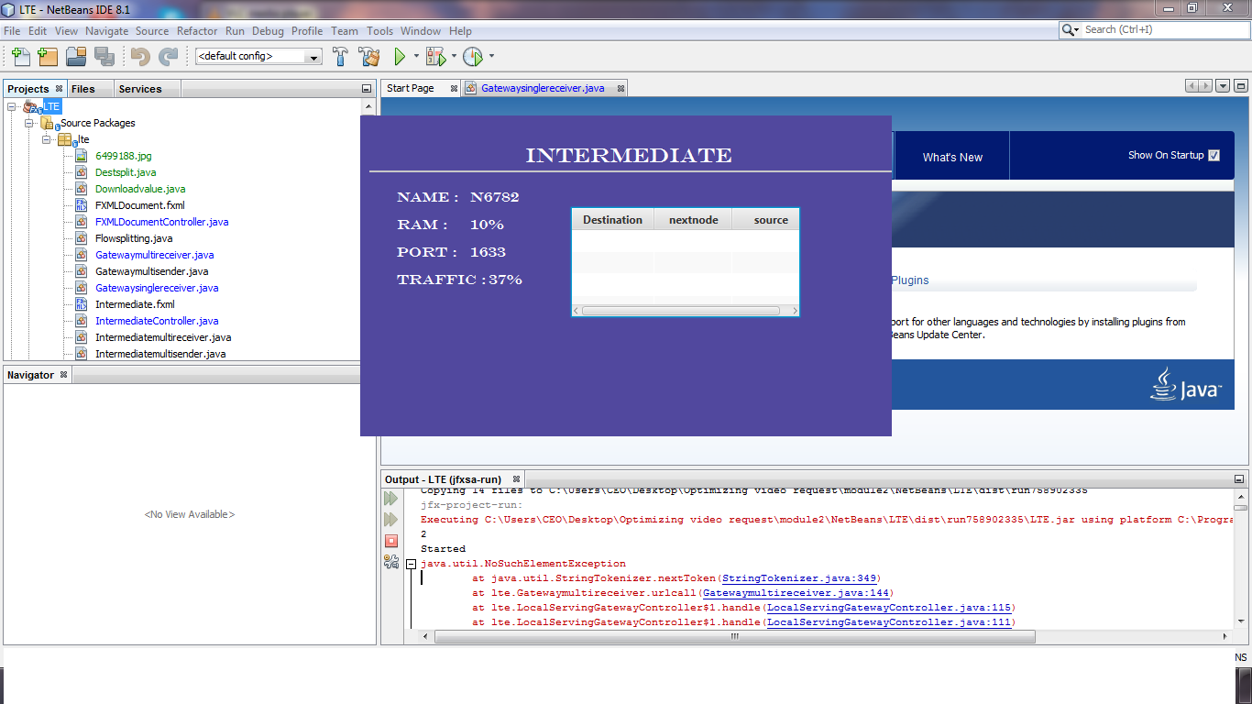

Slide 34
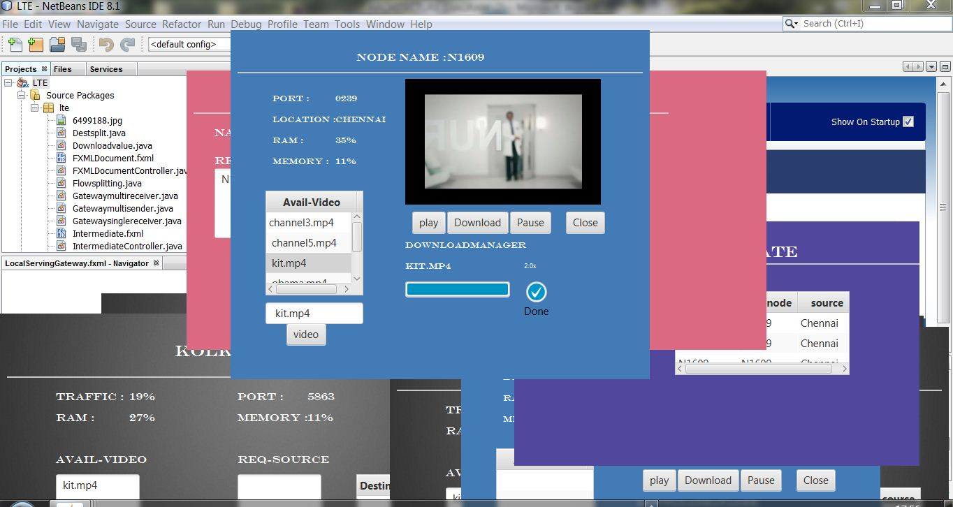

Slide 35
References
V. K. Adhikari, Y. Guo, F. Hao, M. Varvello, V. Hilt, M. Steiner, and Z. Zhang, “Unreeling NetFlix: Understanding and improving multi-CDN movie delivery,” in Proceedings of IEEE INFOCOM, 2012, pp. 1620–1628. [3] J.
He, X. Zhao, and B. Zhao, “A fast, simple and near-optimal content placement scheme for a large-scale VoD system,” in Proceedings of IEEE International Conference on Communication Systems (ICCS), 2012, pp. 378–382. [4] J.
He, H. Zhang, B. Zhao, and S. Rangarajan, “A collaborative framework for in-network video caching in mobile networks,” in Proceedings of IEEE Conference on Sensor, Mesh and Ad Hoc Communications and Networks (SECON), 2013. [5] J.

Slide 36
Thank you!!

